Slide 1
Overview of Machine Learning Models

Slide 2
Machine Learning Systems = Prediction Machines
ML = "Cheap Predictions"
AI = "Cheap Predictions"
Ajay Agrawal
University of Toronto

Slide 3
Kaggle
world's largest community of data scientists and machine learners
- since 2010
- acquired by Google in 2017
- more than 1 million registered users
- Kaggle Competitions
- Public Datasets
- Kaggle Kernels (Jupyter notebooks, code snippets)
Note:
Famous Netflix competition of 2009 was before Kaggle.
Netflix provided a training data set of 100,480,507 ratings
that 480,189 users gave to 17,770 movies.
Task was to improve recommendation engine.
Prize – 1 Mln $

Slide 4
Machine Learning
Deep Learning
Neural Networks (NN)
Perceptron, Multilayer Perceptron
CNN (Convolutional NN)
AutoEncoder, Variational AutoEncoder
Recurrent NNs (RNN)
Exploding/Vanishing Gradient problem
Gated RNNs (LSTM, GRU)
Transformers, BERT
NLP, seq2seq, word2vec, embeddings
NLP, Text mining, sentiment analysis,
Attention, Google Translate
Generative Methods
GANs (Generative Adversarial Networks)
Reinforcement Learning ("Good Puppy")
Agent, Policy, Reward
DeepMind (Atari Games, AlphaGo, etc.)
Linear Regression
Logistic Regression - classification
More classification:
SVM (Support Vector machines)
KNN (K Nearest Neighbors)
K-Means
Decision Trees
Bagging & Boosting,
Random Forest
XGBoost

Slide 5
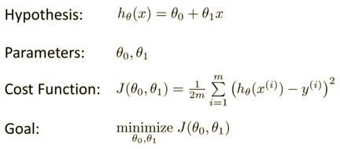
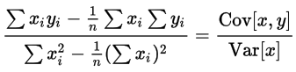
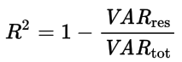
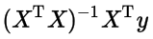
Linear Regression
In simplest case - draw a straight line through data points.
Data is given as tuples (x,y).
We want to draw line y = f(x) = ax + b,
where a & b are numbers (a - slope, b – intercept).
In more general case, “x” and “a” are vectors.
Always make sure that variation of (y-f) is much less than total variation of y. It is called coefficient of determination R² ("R squared”) and it should be close to 1 :
Calculations for simple case:
Method 1 – in Excel, pandas, and many libraries – use OLS functions
(OLS = Ordinary Least Squares).
Method 2 – do calculations yourself:
For more complex case – you can find minimum iteratively using gradient descent.
Or find “slope” by using inverse matrix (if possible - see Moore–Penrose pseudoinverse matrix):

Slide 6
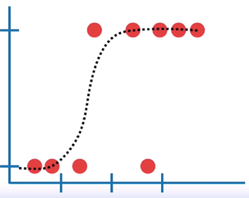
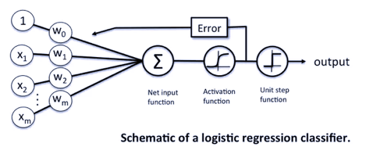
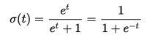
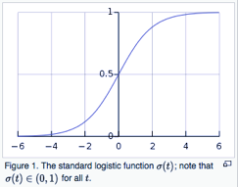
Logistic Regression
Logistic Function
sigma function σ(t) squeeze values into interval (0,1)
In Logistic Regression we model log-likelihood
as a linear combination of some predictors:
logit(p) = log(p/(1-p)) = b0 + b1*x1 + b2*x2 + . . . + bN*xN
Term: “p” - probability of success (then (1-p) is the probability of failure).
Term: Odds (a.k.a. likelihood) of success is the ratio p/(1-p)
Term: Log-likelihood = log(likelihood) = log(p/(1-p))
Term: Logit function logit(p) = log(p/(1-p))
Term: Logistic function σ(t) = 1/(1+exp(-t)) # inverse of logit

Slide 7
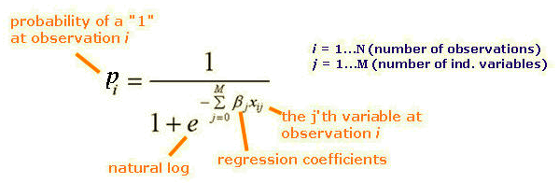
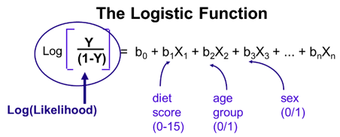
Logistic Regression
We model odds of success or failure as a linear function of some predictor variables.
If “p” is probability of success, then (1-p) is the probability of failure.
Odds (a.k.a. likelihood) of success is the ratio p/(1-p)
Odds may vary from zero to very large values.
In practice we use logarithm of that:
log(likelihood) = log(odds) = log(p/(1-p))
Term: Log-likelihood = log(likelihood)
Term: Logit function logit(p) = log(p/(1-p))
Term: Logistic function σ(t) = 1/(1+exp(-t)) # inverse of logit
In Logistic Regression we model log-likelihood as a linear combination of some predictors:
logit(p) = b0 + b1*x1 + b2*x2 + . . . + bN*xN

Slide 8
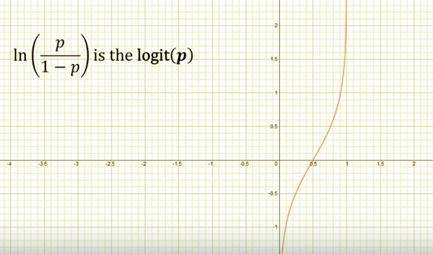
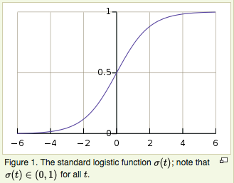
Logistic Function
sigma function σ(t) squeeze values into interval (0,1)
inverse of Logistic function - function logit(p) :

Slide 9
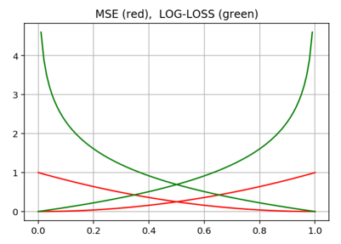
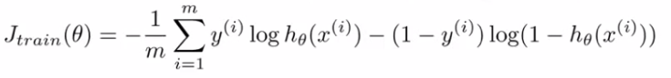
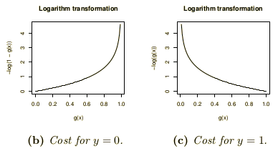
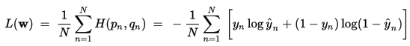
Logistic Regression
Goal - find parameters of a (function or network) to split data into categories (two or more categories).
We can find parameters either analytically (sometimes), or via
gradient descent. For GD we define cost function so that it strongly penalize for wrong categorization (cost J(θ) grows to infinity).
Consider simple case of 2 categories (y = 0 or y=1). ”h” is the prediction of the model, “y” is the label (0 or 1). Then we can represent
Cost function like cross-entropy between “h_{θ}” and “y”:
Log-Loss error function is better:
If “q” is model prediction, and “p” is probability of actual label, then similarity between q & p can be expressed as cross-entropy H(p,q):
So the loss function can be written like this:

Slide 10
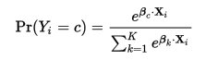
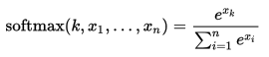
Multinomial logistic regression
generalizes logistic regression to multiclass problems, i.e. with more than two possible discrete outcomes.
(The output number may have values 1,2,3, …K)
Multinomial logistic regression is known by a variety of other names, including
- polytomous LR,
- multiclass LR,
- softmax regression,
- multinomial logit,
- maximum entropy (MaxEnt) classifier,
- conditional maximum entropy model
The function on the right is a variation of softmax function. It is called this way because the effect of exponentiating the values is
to exaggerate the differences between them.
As a result, softmax() will return a value close to 0 whenever x is significantly
less than the maximum of all the values, and will return a value close to 1
when applied to the maximum value.

Slide 11
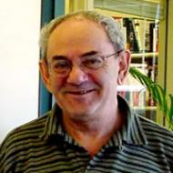
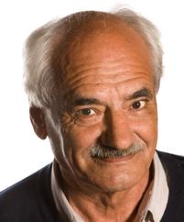
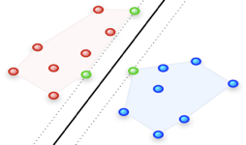
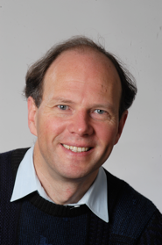
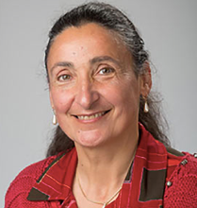
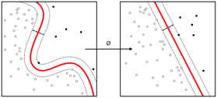
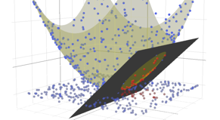
Support Vector Machine (SVM)
The original SVM algorithm was invented by Vladimir N. Vapnik and Alexey Ya. Chervonenkis in 1963. In 1992, Bernhard E. Boser, Isabelle M. Guyon and Vladimir N. Vapnik suggested a way to create nonlinear classifiers by applying the kernel trick to maximum-margin hyperplanes.
A vanilla SVM is a type of linear separator. We draw a straight line through our data down the middle to separate it into two classes.
If we can't draw a line through data, we can transform the data into a feature representation where the separation becomes possible.
“kernel trick” – use “kernel functions”, which enable them to operate in a high-dimensional, implicit feature space without ever computing the coordinates of the data in that space, but rather by simply computing the inner products between the images of all pairs of data in the feature space. This operation is often computationally cheaper than the explicit computation of the coordinates. This approach is called the "kernel trick".
Vladimir N. Vapnik
Alexey Chervonenkis
Isabelle M. Guyon
Bernhard E. Boser

Slide 12

SVM Continued ...
A nonlinear classification problem can be converted to a linear classification problem by mapping the input vectors from the input space to a higher dimensional feature space.
A kernel is a similarity function. It is a function that you, as the domain expert, provide to a machine learning algorithm. It takes two inputs and spits out how similar they are. You use kernels instead of dot-products of your vectors.
Many machine learning algorithms can be expressed entirely in terms of dot products.
Mercer's theorem: Under some conditions, every kernel function can be expressed as a dot product in a (possibly infinite dimensional) feature space.
In many cases, computing the kernel is easy, but computing the feature vector corresponding to the kernel is really really hard. The feature vector for even simple kernels can blow up in size.
For kernels like the RBF (Radial Basis Function) kernel ( k(x,y) = exp( -||x-y||^2),
the corresponding feature vector is infinite dimensional. Yet, computing the kernel is almost trivial.
Many machine learning algorithms can be written to only use dot products,
and then we can replace the dot products with kernels.
By doing so, we don't have to use the feature vector at all. This means that we can work with highly complex, efficient-to-compute, and yet high performing kernels without ever having to write down the huge and potentially infinite dimensional feature vector.
Polynomial kernels can be thought of projecting a vector into a higher dimensional space. Gaussian kernel can be thought as a projection into infinite-dimensional space because its Taylor expansion has infinite number of elements.

Slide 13
K-Nearest Neighbors (KNN)
Identify new data based on proximity to old data.

Slide 14
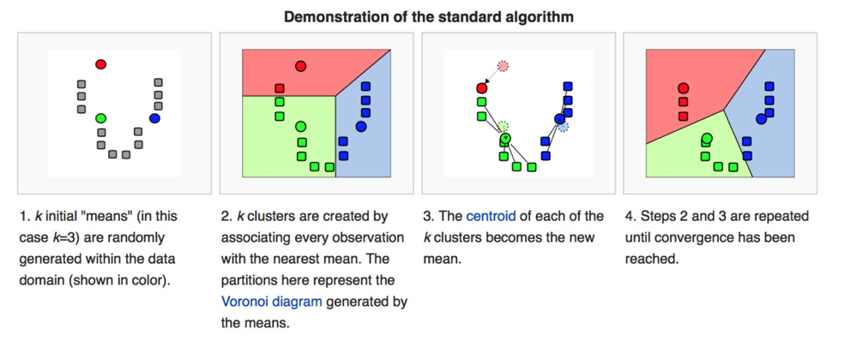
K-means clustering - partition “n” observations into “k” clusters in which each observation belongs to the cluster with the nearest mean, serving as a prototype of the cluster.
The most common algorithm uses an iterative refinement technique, alternating between two steps:
- Assignment step: Assign each observation to the cluster whose mean has the least squared Euclidean distance, this is intuitively the "nearest" mean.
- Update step: Calculate the new means to be the centroids of the observations in the new clusters.

Slide 15
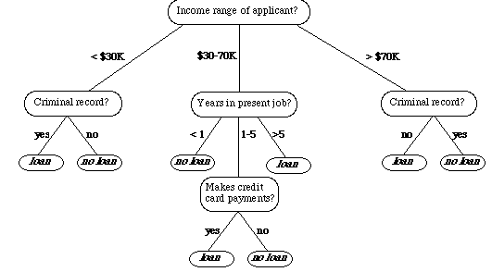
Decision Tree (DT)
DT goes from observations about an item (represented in the branches) to conclusions about the item's target value (represented in the leaves). DT can do classification or regression. DTs are intuitive and easily interpretable.
Algorithms for constructing DTs usually work top-down, by choosing a variable at each step that best splits the set of items We test all possible splits (or some subset) to decide how to split. Simplicity is best, so we want to keep our tree small. To do so, at each step we should choose the split that results in the purest daughter nodes.
There are many specific decision-tree building algorithms, for example:
- ID3 (Iterative Dichotomiser 3) and its successor C4.5
- CART (Classification And Regression Tree)
- CHAID (CHi-squared Automatic Interaction Detector). Performs multi-level splits when computing classification trees.
- MARS: extends decision trees to handle numerical data better. - Conditional Inference Trees. Statistics-based approach that uses non-parametric tests as splitting criteria, corrected for multiple testing to avoid overfitting. This approach results in unbiased predictor selection and does not require pruning.

Slide 16
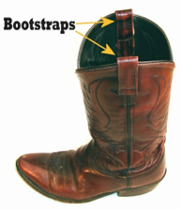
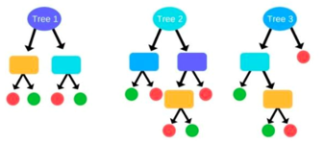
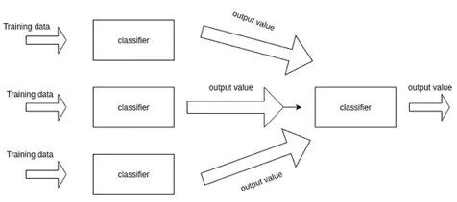
Ensemble Learning Methods with Decision Trees Main idea - a group of “weak learners” come together (vote) to form a “strong learner”.
Democratic voting (with equal or different voting weights).
Three main ways - Bagging, Boosting, Stacking
Bagging reduces variance, Boosting reduces bias, Stacking improve predictive force.
Example of parallel equal-weight voting (Random Forest):
Note - Random Forest is a specific case of Bagging (Bootstrap Aggregating)
You have N = 1 million photos to train an algorithm to determine if a photo has an elephant in it.
You train approx sqrt(N) = 1000 decision trees.
Each tree get a random subset of data (for example, 10K photos),
Each tree get a random subset of features to look for (legs, trunk, ears, etc.).
Once trained, these trees can "look" at a test photo - and vote their decision
(is there an elephant there or not?.
Example of sequential weighted voting (Boosting):
You train first tree - and select examples on which it gives wrong answers.
Then you train 2nd tree on these examples - and let two trees vote
(with weights) to get best result. Then you select exampels for which this
two-tree system still gives error - and train a 3rd model, etc. etc.
Continue adding trees and adjust their weights to reduce errors.
Stacking (Meta-learner) - train several different models,
and then train model on top of their outputs
- https://www.kdnuggets.com/2017/02/stacking-models-imropved-predictions.html
bootstrap - pull oneself by one's bootstraps

Slide 17
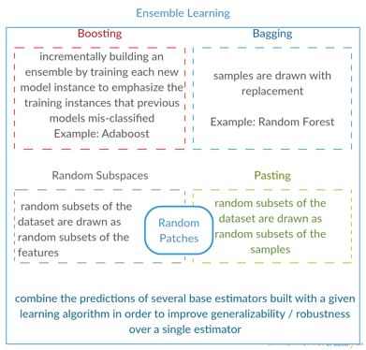
XGBoost is a library designed and optimized for boosting trees algorithms.
- https://xgboost.readthedocs.io/en/latest/model.html
XGBoost is short for “Extreme Gradient Boosting”
Gradient boosting trees model is originally proposed by Friedman et al. :
“Gradient Boosting” - Greedy Function Approximation: A Gradient Boosting Machine, by Friedman (1999)
- https://statweb.stanford.edu/~jhf/ftp/trebst.pdf
Tianqi Chen - Introduction to Boosted Trees (2016)
- http://homes.cs.washington.edu/~tqchen/pdf/BoostedTree.pdf
The underlying algorithm of XGBoost is similar, specifically it is an extension of the classic gbm algorithm.

Slide 18
XGBoost (Extreme Gradient Boosting, 2014)
vs GBM (Gradient Boosting Machine, 1999).
GBM
xgboost
- uses "Regularized Gradient Boosting" model which prevents overfitting and gives better performance
- uses sparse matrices with sparsity aware algorithms to reduce memory and increase performance
- better support for multicore parallel processing - reduces training time
2015 - DART: Dropouts meet Multiple Additive Regression Trees
- https://arxiv.org/abs/1505.01866
- http://zhanpengfang.github.io/418home.html
- https://www.analyticsvidhya.com/blog/2016/03/complete-guide-parameter-tuning-xgboost-with-codes-python/
- https://www.quora.com/What-is-the-difference-between-the-R-gbm-gradient-boosting-machine-and-xgboost-extreme-gradient-boosting
- https://en.wikipedia.org/wiki/Gradient_boosting
- https://en.wikipedia.org/wiki/Xgboost
Note:
Gradient Boosting is named so because on each steep it is improving (boosting) the decision by decreasing the error (Gradient Descent)
- http://www.becomingadatascientist.com/2016/08/06/boosting-in-machine-learning-as-a-metaphor-for-diverse-teams/#comment-2749

Slide 19
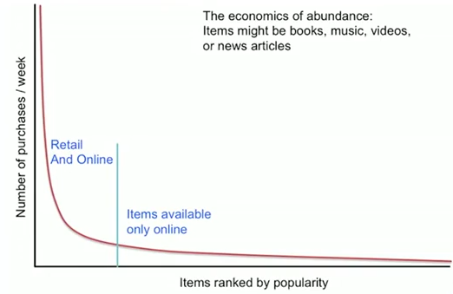
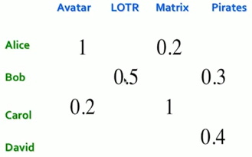
Recommender Systems
1. Content based (CB)
2. Collaborative filtering (CF)
3. Latent factor based
Long Tail
Total sales in long-tail may be big, but sales of each individual item are small and each item is almost invisible. Recommendations help.
- Lists of favorites, “essential” items
- List of “Top 10”, Most popular, New items
- Tailored to individual users
Utility Matrix for movies vs users:
Ratings:
- Explicit reviews and ratings
- Implicit from user buying behavior
Problem: Utility Matrix is very sparse, most people haven’t rated most items.
New items have no ratings, new users have no ratings

Slide 20
Content-based Recommender Systems
Recommendations based on user history.
We build item profiles (vectors of features) and user profiles (vectors of feature preferences).
Then we match them (dot-product, angle between vectors)
For each item – profile, vector of features (for example, comedy, action, actor, director, etc.)
How to extract most important features? Most important words/terms?
TF_IDF stands for Term Frequency - Inverse Document Frequency,
It is calculated by multiplying two numbers: TF_IDF = TF * IDF
where:
TF(t) = (Number of times term t appears in a document) / (Total number of terms in the document).
IDF(t) = log(Total number of documents / Number of documents with term t in it).
Doc profile – set of words with highest TF-IDF scores, together with their scores
User Profile:
user has rated … or user has bought …
Simple – take weighted average of items’ features, normalize by average rating of the user.
Problem – will never recommend anything which doesn’t fit user’s history.
What to recommend to a new user?

Slide 21
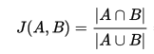
Collaborative filtering (CF)
CF is a technique used by recommender systems.
CF is a method of making automatic predictions (filtering) about the interests of a user
by collecting preferences or taste information from many users (collaborating).
Typically, the workflow of a collaborative filtering system is:
- A user expresses his or her preferences by rating items (e.g. books, movies or CDs) of the system. These ratings can be viewed as an approximate representation of the user's interest in the corresponding domain.
- The system matches this user's ratings against other users' and finds the people with most "similar" tastes.
- With similar users, the system recommends items that the similar users have rated highly but not yet being rated by this user (presumably the absence of rating is often considered as the unfamiliarity of an item).
How to tell that users are similar?
Option 1 - The Jaccard index (a.k.a. “Intersection over Union” or “Jaccard similarity coefficient”), originally coined coefficient de communauté by Paul Jaccard.
Problem – it doesn’t account for the value of a rating.
Option 2 - Better approach – look at similarity of feature vectors (cosine similarity).
Problem here – how to deal with missing (not rated) components of vectors.
Option 3 – Centered cosine (Pearson correlation) – subtracting the row (user) mean to center around zero. Then missing data is treated as “average”. Also helps to resolve “tough rates vs easy rates” problem.
Intersection
Jaccard index
Union

Slide 22
Collaborative filtering (CF) - continued
Once we have identified features for each movie,
and identified preferences for users,
we can identify users similar to our user.
Then we can make predictions by calculating similarities
between their items and our user
(and normalizing by sum of all their similarities).
Then we take top-10 of those weighted similarities.
This was user-to-user collaborative filtering.
We can also do item-to-item CF.
For each item we will find similar items,
calculate similarity, use weighted similarity – and select top 10.
Item-to-item similarity is simpler
(less features, easier to understand)
than user-to-user.
So in real life item-to-item outperforms user-to-user methods.

Slide 23
Collaborative filtering (CF) – continued - implementation
It is expensive (time consuming) to calculate similarity for all users and items.
The complexity is O(U), where U is the size of utility matrix = (Nusers * Nmovies).
Solutions:
- Near-neighbor search in high dimensions (LSH = Locality Sensitive Hashing, etc.)
- Clustering
- Dimensionality reduction
Harry Potter effect
(popularity bias) : recommending a popular item to many users makes it more popular.
Combining item-to-item and user-to-user (Netflix).
Also adding other features (geography, language, age, etc.)
Common practice:
- define similarity of items
- select “K” nearest neighbors
for each pair (item, user)
- estimate ratings as base-line + CF piece
(weighted normalized average)
Testing algorithm: remove some data from Utility matrix – and try to predict it.
Compare actual data with predictions – using root-square measure.
Problems with this:
- prediction diversity (many similar items),
- prediction context (interest exists only during a trip),
- order of predictions
Possible solution – only compare several top ratings.

Slide 24
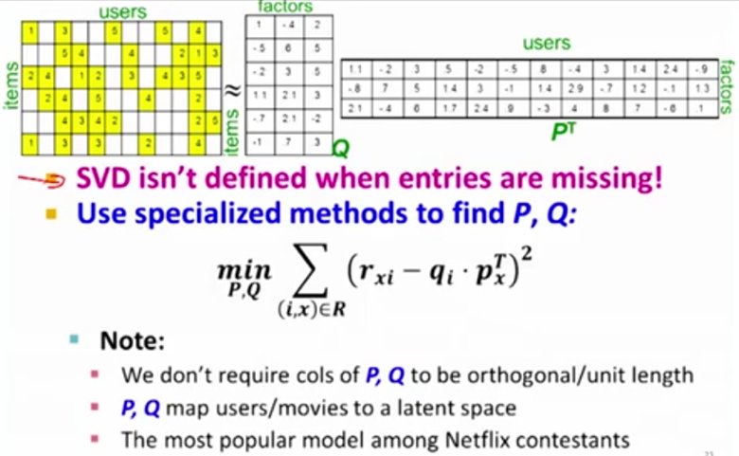
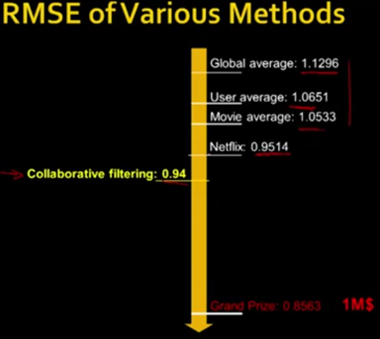
Latent Factor Recommender Systems
Each user is represented as a K-dimensional vector of latent variables.
Each movie is also represented as a K-dimensional vector (in picture below K=3). We decompose original utility matrix into a product of 2 matrixes of latent vectors. This is “matrix factorization”.
To find latent vectors, we solve minimization problem.
Dimensionality Reduction
If some rows/columns of a matrix can be presented as linear combinations of others, this decreases the “rank” of the matrix. We can then reduce the matrix to a smaller matrix (for example, convert from 3D to 2D plane).
Netflix prize (2009)

Slide 25
"Recommender System & Collaborative Filtering"
(from Andrew Ng’s Machine Learning course)
We select n features (like romance, action, etc. – in 0..5 scale).
x - vector of features’ values for a movie.
ϴ - vector of features’ values for user preferences.
y – matrix of ratings users give to movies (matrix size is (N_{users}, N_{movies}))
Given n-features, y & x , we can get ϴ
Given n-features, y & ϴ, we can get x
Or given “y”, we can solve minimization problem against both x & ϴ (and find features).
Note: after you've learned features, it's often very hard to come in and apply a human understandable metric to what those features are.
Andrew uses a (low rank) matrix factorization algorithm. It is similar to the Singular Value Decomposition (SVD = diagonalization / rotation) of “y”. You're trying to compute Θ and X so that (Θ^{T}X−y) is minimal in a sum of squares sense,
subject to a regularization condition and ignoring any values that aren't in y.
The number of features “n” that you elect to use can be seen as corresponding to the number of singular values you'd include if you were reducing the dimensionality of your data using a SVD. If you didn't have any missing data and there were no regularization, these notions would correspond exactly, except that SVD gives you USV^{T}=y , where S is diagonal so the S factors would be smushed into the Θ and X matrices you computed.
Mean Normalization:
Calculate average rating for each movie, and subtract them from ratings for this movie in matrix “y”.
If we run our predictive algorithm for a user with no activity – it will predict zeros for all movies. But then we can add the average value for each movie – and recommend the ones with higher averages.

Slide 26
Tutorial on how to do a recommender system using python, pandas, numpy, sklearn, ast (abstract syntax tree).
- https://www.datacamp.com/community/tutorials/recommender-systems-python
Amazon has released their recommendation engine as open source:
- https://github.com/amzn/amazon-dsstne
Amazon DSSTNE: Deep Scalable Sparse Tensor Network Engine
DSSTNE (pronounced "Destiny") is an open source software library
for training and deploying recommendation models
with sparse inputs, fully connected hidden layers, and sparse outputs.
Models with weight matrices that are too large for a single GPU
can still be trained on a single host.
DSSTNE has been used at Amazon to generate personalized product
recommendations for our customers at Amazon's scale.
It is designed for production deployment of real-world applications
which need to emphasize speed and scale over experimental flexibility.
Miscellaneous Notes:
deFinetti Theorem:
Exchangeable random variable can be rewritten as product of independent variables conditioned on some parameter (root cause).
Aldous Hoover Factorization,
variants
Bias (user bias, product bias)
Ratings are not random.
Distribution is not even.
It may be bi-modal (love/hate),
or skewed to one side.

Slide 27
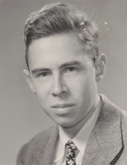
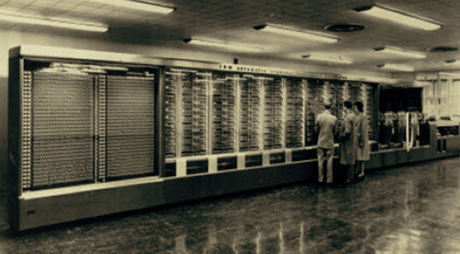
Frank Rosenblatt
(1928-1971)
Perceptron - 1957
Born in New Rochelle, New York Graduated from The Bronx High School of Science, then Cornell University BA 1950, Ph.D. 1956.
Worked at Cornell Aeronautical Laboratory in Buffalo, NY
Conducted the early work on perceptrons,
which culminated in the development and hardware construction of the Mark I Perceptron in 1960. This was essentially the first computer that could learn new skills by trial and error,
using a type of neural network that simulates human thought processes.
Single-Layer Network Perceptron. The machine was connected to a camera that used 20×20 cadmium sulfide photocells to produce a 400-pixel image. The main visible feature is a patchboard that allowed experimentation with different combinations of input features. To the right of that are arrays of potentiometers that implemented the adaptive weights

Slide 28
Perceptron
(Single Layer)
Multilayer Perceptron

Slide 29
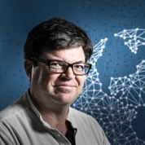
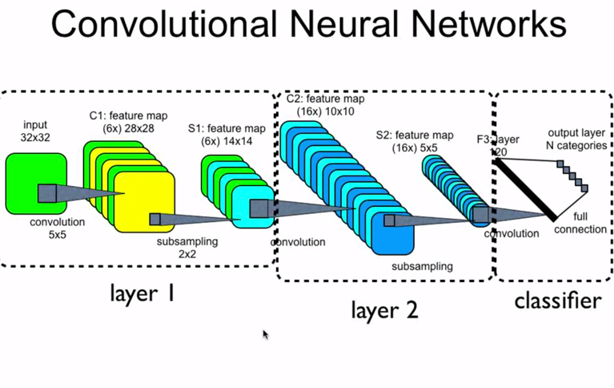
Question 1. C1 in the layer 1 has 6 feature maps, does that mean there are six convolutional kernels?
Each convolutional kernel is used to generate a feature map based on input.
There are 6 convolutional kernels and each is used to generate a feature map based on input.
Another way to say this is that there are 6 filters or 3D sets of weights.
What this image doesn't show, that it probably should, to make it clearer is that typically images have 3 channels, say red, green, and blue. So the weights that map you from the input to C1 are of shape/dimension 3x5x5 not just 5x5. The same 3 dimensional weights, or kernel, are applied across the entire 3x32x32 image to generate a 2 dimensional feature map in C1. There are 6 kernels (each 3x5x5) in this example so that makes 6 feature maps ( each 28x28 since the stride is 1 and padding is zero) in this example, each of which is the result of applying a 3x5x5 kernel across the input.
Question 2. S1 in layer 1 has 6 feature maps, C2 in layer 2 has 16 feature maps. What is the process look like to get these 16 feature maps based on 6 feature maps in S1?
Now do the same thing we did in layer one, but do it for layer 2, except this time the number of channels is not 3 (RGB) but 6, six for the number of feature maps/filters in S1. There are now 16 unique kernels each of shape/dimension 6x5x5. Each layer 2 kernel is applied across all of S1 to generate a 2D feature map in C2. This is done 16 times for each unique kernel in layer 2, all 16, to generate the 16 feature maps in layer 2 (each 10x10 since stride is 1 and padding is zero).
Yann LeCun (NYU, FB) 1998 paper on LeNets

Slide 30
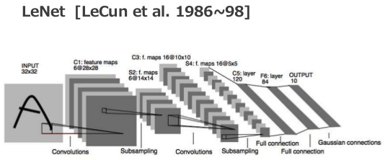
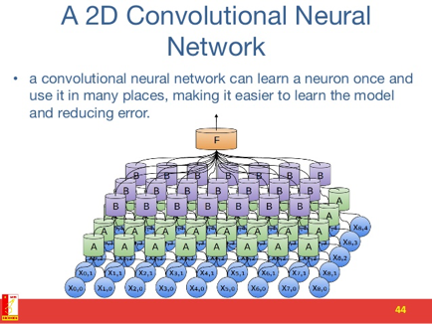
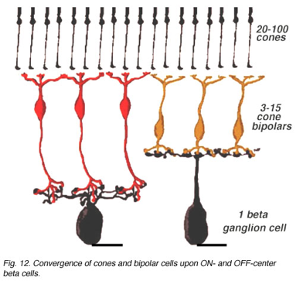


Slide 31
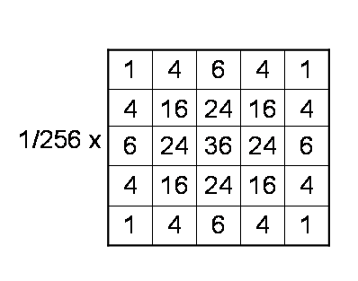
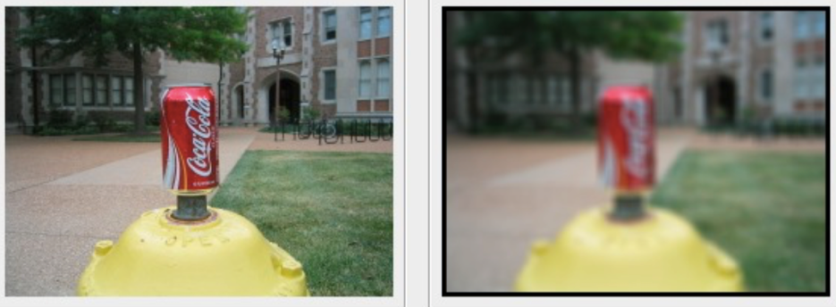
Example of 2D convolution – Gaussian Filtering
Kernel
has small size
Input
Output

Slide 32
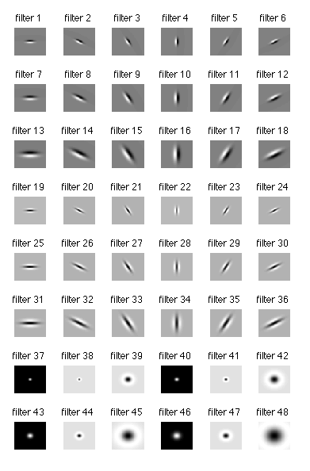
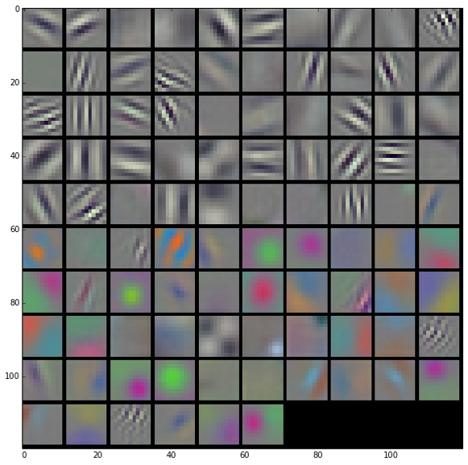
Convolution Filters (learned in 1st layer)

Slide 34
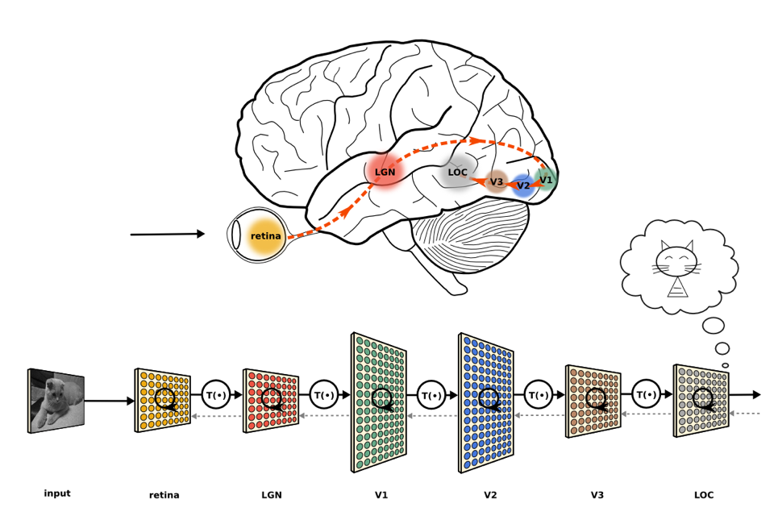
Another path through the brain when viewing an object, this time using V3

Slide 35
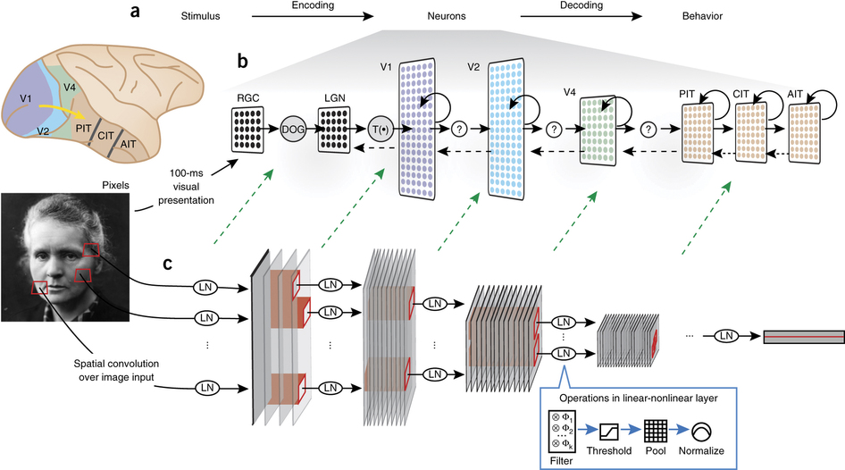

Slide 36
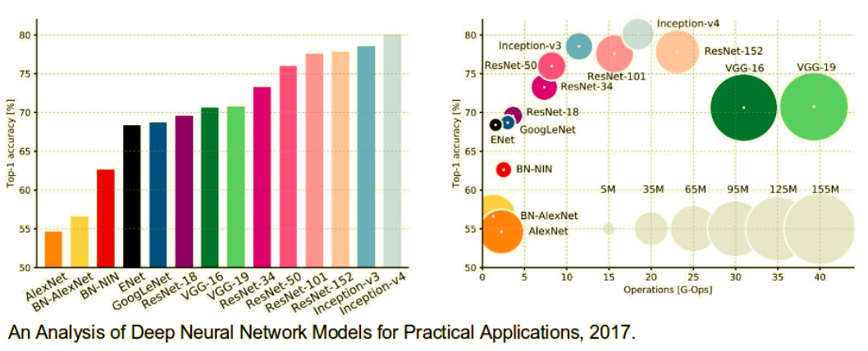
CNNs Architectures: LeNet, AlexNet, VGG, GoogLeNet, ResNet and more …
https://medium.com/@siddharthdas_32104/cnns-architectures-lenet-alexnet-vgg-googlenet-resnet-and-more-666091488df5

Slide 37


Autoencoders (AE)
Autoencoders (AE):
- feed-forward network
- create approximate copy
- dimensionality reduction (usually)
- feature learning
Can be trained as feedforward network with all of the same techniques, typically
minibatch gradient descent
following gradients computed by back-propagation.
Unlike general feedforward networks, autoencoders may also be trained using recirculation (Hinton and McClelland, 1988), a learning algorithm based on comparing the activations of the network on the original input to the activations on the reconstructed input.
x
h = f(x)
h
r = g(x)
r
Dimensionality reduction, feature learning
reconstruction

Slide 38
Autoencoder – denoising, correcting, gap filling

Slide 39
Variational Autoencoders (AE)

Slide 40


Time Series Analysis
Predicting call volume, stock price, weather, next word or next note, etc.
Forecasting methods:
1. Qualitative
2. Causal (cause-effect) – for example a price drop usually causes predictable
call volume increase over some time. We can learn the shape of this increase
from historic data - and apply adjusted versions going forward
3. Time series analysis (Linear Regression (Ridge, LASSO, ElasticNet),
Exponential Smoothing (using window): s(t+1) = a*x(t) + (1-a)*s(t)
Holt-Winters = Triple Exponential Smoothing (value, slope, by cycle)
ARMA (Auto-Regressive Moving Average) – signal + noise, extrapolation,
ARIMA (Auto-Regressive Integrated Moving Averages))
trends, auto-correlations, bivariate cross-correlation, etc.
multivariate time series analysis
seasonality in the model using Fourier decomposition over 4+ years
4. Simulation (random walk, MCMC – Markov Chain Monte-Carlo, etc.)
5. Machine Learning - LSTM (also multivariate LSTM), Random Forest, etc.

Slide 41


Monte Carlo Examples:
In the example above relative error is ~1/sqrt(N)
= 1/sqrt(259.0) = 0.062 (or ~6%)
MCMC – Markov Chain Monte Carlo (random walk)

Slide 42






What is “Monte Carlo” ?
Monte Carlo method - use random sampling to obtain numerical results. It was invented in the late 1940s by Stanislaw Ulam, while he was working on nuclear weapons projects at the Los Alamos National Laboratory.
Nicholas Metropolis has suggested using the name Monte Carlo, which refers to the Monte Carlo Casino in Monaco.
Monte Carlo officially refers to an administrative area of the Principality of Monaco, specifically the ward of Monte Carlo/Spélugues, where the Monte Carlo Casino is located.
Casino’s name “Monte Carlo” means literally "Mount Charles”. It was chosen in 1863 in honor of Charles III, Prince of Monaco.
Stanislaw Ulam
John von Neuman
Nicholas Metropolis

Slide 43


Sequence Modeling: Recurrent and Recursive Nets
Recurrent Neural Networks or RNNs (Rumelhart et al., 1986a)
are a family of neural networks for processing sequential data.
Can process long sequences and sequences of variable length.
Idea – use parameter sharing.
Idea – use convolution across a 1-D temporal sequence.
The output of convolution is a sequence
where each member of the output is a function
of a small number of neighboring members of the input.
Recurrent networks share parameters in a different way.
Each member of the output is a function of the previous members.
Computational graph includes cycles.
The present value of a variable influences
its own value at a future time step.

Slide 44
Signal Processing – Digital Filters.
Low-Pass Filter Design
Low-Pass Filtering

Slide 45





Unfolding Computational Graphs.
the idea of unfolding a recursive or recurrent computation into a computational graph that has a repetitive structure,
typically corresponding to a chain of events. For example:
Where ”state of the system” s(t) is a function of the previous state s(t-1)
Each node represents the state at some time t, and the function f() maps the state at time “t” to the state at time “t+1”.
Another example – same, but with additional external signal x(t):
Many recurrent neural networks use the above equation (or a similar equation) to define the values of their hidden units:
Example: the RNN is used to predict the next word given previous words. It may not be necessary to store all of the information in the input sequence up to time t, but rather only enough information to predict the rest of the sentence.

Slide 46

Gated RNNs – LSTM, GRU
LSTM = Long Short-Term Memory
GRU = Gated Recurrent Unit
Nodes have internal structure with gates which can open/close.
GRU has become more popular than LSTM recently because GRU is simpler and "cheaper" to calculate

Slide 47

LSTM
LSTM = Long Short-Term Memory
Imagine Recurrent Neural Network trying to recognize music sampled at 44KHz.
The 10 sec phrase will be 440,000 points. And when training – how we keep track of so many points going backwards?
This is the exploding or vanishing gradient problem.
Solution - instead of propagating analog gradients backwards,
we use "gates" (all or nothing).
A simple LSTM block with only input, output, and forget gates. LSTM blocks may have more gates.

Slide 48


A simple LSTM block with only input, output, and forget gates. LSTM blocks may have more gates.
Sepp Hochreiter, Austria
- http://www.bioinf.jku.at/people/hochreiter/
Jürgen Schmidhuber, Switzerland
- http://people.idsia.ch/~juergen/
LSTM - Long short-term memory (1997)
Hochreiter, Sepp; and Schmidhuber, Jürgen; Long Short-Term Memory, Neural Computation, 9(8):1735–1780, 1997
https://en.wikipedia.org/wiki/Long_short-term_memory
LSTM is a special type of RNN where nodes (blocks) have internal structure with gates which can learn to open/close. LSTM overcomes the problem of vanishing gradients for long sequences.

Slide 49
NLP = Natural Language Processing
Language translation
Language understanding
Text Mining
Chatbots (Amazon Lex, Google Dialogflow, etc.) – long way since ELIZA chatbot (MIT, 1964-1966)
NLP is often used in combination with speech recognition (Siri (Apple), Cortana (Microsoft), Google Assistant)
Text classification, topics, sentiment analysis.
NLP typically relies on sequential algorithms. We process natural language as a sequence of words in extremely large, sparse, high-dimensional vectors.
A language model describes a probability distribution over a sequence of tokens in a natural language.
A token could be a word, character, or byte, depending on how the model is designed.
bag-of-words - very simple model where a text is represented as the bag of its words, disregarding grammar and even word order but keeping count (frequency) of each word in the text.
n-gram - a sequence of n tokens (can be phonemes, syllables, letters, words or base pairs according to the application).
The earliest NLP models were built on the concept of n-grams.

Slide 50
Stemming & Lemmatization
process of reducing inflected (or derived) words to their word stem, base or root form
“lemma” = the base or dictionary form of a word
Example of data preparation:
1. Stop word removal: Certain words like "and," "the," and "of," are very common in all English sentences and are not very meaningful in deciding spam/nonspam status, so these words have been removed from the emails.
2. Lemmatization: Words that have the same meaning but different endings have been adjusted so that they all have the same form. For example, "include", "includes," and "included," would all be represented as "include." All words in the email body have also been converted to lower case. 3. Removal of non-words: Numbers and punctuation have both been removed. All white spaces (tabs, newlines, spaces) have all been trimmed to a single space character.
import nltk
ps = nltk.stemmer.PorterStemmer()
print ps.stem('grows') # 'grow'
print ps.stem('leaves') # 'leav'
print ps.stem('fairly') # 'fairli'
import nltk
sno = nltk.stem.SnowballStemmer('english')
print sno.stem('grows') # 'grow'
print sno.stem('leaves') # 'leav'
print sno.stem('fairly') # 'fair'
# you need to tokenize before running through a stemmer
from nltk import word_tokenize
from nltk.stem import WordNetLemmatizer
wnl = WordNetLemmatizer()
ss = "the woman's going home"
aa = []
for token in word_tokenize(ss) :
aa.append(wnl.lemmatize(token))
print aa # ['the', 'woman', "'s", 'going', 'home']
#
# how to modify stemming
#
from nltk.stem import snowball
stemmer = snowball.EnglishStemmer()
stemmer.stem('thee') # u'thee'
print dir(stemmer) # . . .
print stemmer._EnglishStemmer__special_words # { . . . }
stemmer._EnglishStemmer__special_words['thee'] = 'thou'
print stemmer.stem('thee') # 'thou'
import nltk
nltk.download('wordnet')
from nltk.stem.wordnet import WordNetLemmatizer
lmtzr = WordNetLemmatizer()
print lmtzr.lemmatize('cars') # 'car'
print lmtzr.lemmatize('feet') # 'foot'
print lmtzr.lemmatize('people') # 'people'
print lmtzr.lemmatize('fantasized','v') # 'fantasize'

Slide 51
Sentiment Analysis
analyze texts to find out how people feel about a topic
(positive/negative/neutral).
from senti_classifier import senti_classifier
sentences = [’I love you’, ‘I hate you’]
pos_score, neg_score = senti_classifier.polarity_scores(sentences)
print pos_score, neg_score
import nltk
from nltk.tokenize import word_tokenize
from nltk.sentiment.util import *
from nltk.sentiment.vader import SentimentIntensityAnalyzer as sia
text=["i have a good feeling about this."]
text1='she has the worse character in the class'
sid=sia()
for word in text:
ss = sid.polarity_scores(word)
print ss
nltk.sentiment.util.demo_vader_instance(text1)
nltk.sentiment.util.demo_liu_hu_lexicon(tex
t1, plot=False)
from pycorenlp import StanfordCoreNLP
nlp = StanfordCoreNLP('http://localhost:9000')
res = nlp.annotate("""I love you. I hate him. You are nice. He is dumb""", properties={ 'annotators': 'sentiment',
'outputFormat': 'json',
'timeout': 1000, })
for s in res["sentences"]:
print "%d: '%s': %s %s" % (
s["index"],
" ".join([t["word"] for t in s["tokens"]]),
s["sentimentValue"], s["sentiment"])
and you will get:
# output:
# 0: 'I love you .': 3 Positive
# 1: 'I hate him .': 1 Negative
# 2: 'You are nice .': 3 Positive
# 3: 'He is dumb': 1 Negative
# TensorFlow & LSTM
from __future__ import division, print_function, absolute_import
import os
import tflearn
from tflearn.data_utils import to_categorical, pad_sequences
from tflearn.datasets import imdb
# IMDB Dataset loading
train, test, _ = imdb.load_data(path='imdb.pkl', n_words=100,
valid_portion=0.1)
trainX, trainY = train
testX, testY = test
# Data preprocessing
# Sequence padding
trainX = pad_sequences(trainX, maxlen=100, value=0.)
testX = pad_sequences(testX, maxlen=100, value=0.)
# Converting labels to binary vectors
trainY = to_categorical(trainY, nb_classes=2)
testY = to_categorical(testY, nb_classes=2)
# Network building
net = tflearn.input_data([None, 100])
net = tflearn.embedding(net, input_dim=10000, output_dim=128)
net = tflearn.lstm(net, 128)
net = tflearn.fully_connected(net, 2, activation='softmax')
net = tflearn.regression(net, optimizer='adam', learning_rate=0.001,
loss='categorical_crossentropy')
# Training
model = tflearn.DNN(net, tensorboard_verbose=0)
model.fit(trainX, trainY, validation_set=(testX, testY), show_metric=True,
batch_size=32)
from nltk.corpus import sentiwordnet as swn
breakdown = swn.senti_synset('breakdown.n.03')
print breakdown.pos_score()
print breakdown.neg_score()
print breakdown.obj_score()
print list(swn.senti_synsets('slow'))
happy = swn.senti_synsets('happy', 'a')
all = swn.all_senti_synsets()
Using sklearn & nltk:
http://www.pitt.edu/~naraehan/presentation/Movie+Reviews+sentiment+analysis+with+Scikit-Learn.html
import sklearn
from sklearn.datasets import load_files
movie_train = load_files(moviedir, shuffle=True)
from sklearn.feature_extraction.text import CountVectorizer
import nltk
foovec = CountVectorizer(min_df=1, tokenizer=nltk.word_tokenize)
# Convert raw frequency counts into TF-IDF
# (Term Frequency -- Inverse Document Frequency) values
from sklearn.feature_extraction.text import TfidfTransformer
tfidf_transformer = TfidfTransformer()
sents_tfidf = tfidf_transformer.fit_transform(sents_counts)
print sents_tfidf.toarray()
...

Slide 52
TF-IDF
TF_IDF stands for Term Frequency - Inverse Document Frequency,
It is calculated by multiplying two numbers: TF_IDF = TF * IDF
where:
TF(t) = (Number of times term t appears in a document) / (Total number of terms in the document).
IDF(t) = log(Total number of documents / Number of documents with term t in it).
Example:Consider a document containing 100 words wherein the word “cat” appears 3 times.
TF = (3 / 100) = 0.03. Now, assume we have 10 million documents and the word cat appears in one thousand of these.
Then, the inverse document frequency IDF = log(10,000,000 / 1,000) = 4. Thus TF_IDF = TF * IDF = 0.03 * 4 = 0.12
Note – for common “stop” words (“a”, “the”, “to”, “and”, “of”, etc.) the TF_IDF value is very close to zero.
Variations of the TF_IDF weighting scheme are often used by search engines as a central tool in scoring and ranking a document's relevance given a user query. One of the simplest ranking functions is computed by summing the TF_IDF for each query term. TF_IDF can be successfully used for stop-words filtering in various subject fields including text summarization and classification.
Books:
Bruce Croft “Search Engines: Information Retrieval in Practice”
Christopher Manning “Introduction to Information Retrieval”

Slide 53
Topic Modeling
Topic modeling is a machine learning method for discovering “topics” that occur in a collection of documents.
You can train topic models to create summaries of the text.
Models: Latent Dirichlet allocation (LDA), Labeled LDA, PLDA new, word2vec
LDA is a technique that facilitates the automatic discovery of themes in a collection of documents
- http://people.csail.mit.edu/dsontag/courses/pgm13/slides/BleiNgJordan2003.pdf
- https://eight2late.wordpress.com/2015/09/29/a-gentle-introduction-to-topic-modeling-using-r/
Latent Dirichlet Allocation (LDA) is a generative probabilistic model for collections of discrete data such as text corpora.
David M. Blei , Andrew Y. Ng, Michael I. Jordan (2003)
LDA is a three-level hierarchical Bayesian model, in which each item of a collection is modeled as a finite mixture over an underlying set of topics.
Each topic is, in turn, modeled as an infinite mixture over an underlying set of topic probabilities. In the context of text modeling, the topic probabilities provide an explicit representation of a document.
Note: abbreviation "LDA" is also used for Linear Discriminant Analysis (LDA) - a statistical method to find a linear combination of features to achieve separation of two or more classes. Used for dimensionality reduction before classification. Similar to PCA (Principal Component Analysis).
from __future__ import division, print_function
import numpy as np
import lda
import lda.datasets
X = lda.datasets.load_reuters()
vocab = lda.datasets.load_reuters_vocab()
titles = lda.datasets.load_reuters_titles()
doc_id = 0
word_id = 3117
model = lda.LDA(n_topics=20, n_iter=500, random_state=1)
model.fit(X)
topic_word = model.topic_word_
for n in range(5):
sum_pr = sum(topic_word[n,:])
print("topic: {} sum: {}".format(n, sum_pr))
n = 5
for i, topic_dist in enumerate(topic_word):
topic_words = np.array(vocab)[np.argsort(topic_dist)][:-(n+1):-1]
print('*Topic {}\n- {}'.format(i, ' '.join(topic_words)))
doc_topic = model.doc_topic_
print("type(doc_topic): {}".format(type(doc_topic)))
print("shape: {}".format(doc_topic.shape))

Slide 54


word2vec
Word embedding - techniques to map words or phrases from the vocabulary to vectors of real numbers.
Main idea - a word can be described by its “neighbors” – a company that this word has.
Similar words tend to have similar neighbors. Numerical vectors (word embeddings) are constructed so that we can do vector arithmetic on them:
”king” – “he” + “she” ~ “queen”
word2vec is a two-layer neural net that processes text. Its input is a text corpus and its output is a set of vectors of real numbers (typically in ~100 dimensional space).
We train this network to represent meaning (semantics) of words as vectors.
Tomas
Mikolov

Slide 55
Word2vec - a group of models that tries to represent each
word in a large text as a vector in a space of N dimensions
(which we will call features)
making similar words also be close to each other.
V(King) – V(Man) + V(Woman) ~ V(Queen)
Tomas Mikolov published word2vec in 2013.
Note – there are many models in other areas working as “Something-to-vec”, for example: - Node2Vec - node2vec is an algorithmic framework for representational learning on graphs (given any graph, it can learn continuous feature representations for the nodes).
- Dna2vec - vector representations of variable-length k-mers (in long DNA sequence).

Slide 56
The two main models in word2vec: Skip-Gram and Continuous Bag of Words (CBOW).
Both architectures describe how the neural network "learns" the underlying word representations for each word.
Since learning word representations is essentially unsupervised, you need some way to "create" labels to train the model.
Skip-gram and CBOW are two ways of creating the "task" for the neural network -- you can think of this as the output layer of the neural network, where we create "labels" for the given input (which depends on the architecture). For both descriptions below, we assume that the current word in a sentence is w(t).

Slide 57
CBOW (Continuous Bag of Words) : The input to the model could be wi−2,wi−1,wi+1,wi+2, the preceding and following words of the current word we are at.
The output of the neural network will be wi.
Hence you can think of the task as "predicting the word given its context”. Note that the number of words we use depends on your setting for the window size.
Skip-gram: The input to the model is wi, and the output could be wi−1,wi−2,wi+1,wi+2. So the task here is "predicting the context given a word".
Note: more distant words are given less weight by randomly sampling them. When you define the window size parameter, you only configure the maximum window size. The actual window size is randomly chosen between 1 and max size for each training sample, resulting in words with the maximum distance being observed with a probability of 1/c while words directly next to the given word are always(!) observed.
According to Mikolov:
Skip-gram works well with small amount of the training data, represents well even rare words or phrases. CBOW is several times faster to train than the skip-gram, slightly better accuracy for the frequent words. This can get even a bit more complicated if you consider that there are two different ways how to train the models: the normalized hierarchical softmax, and the un-normalized negative sampling. Both work quite differently.
This makes sense since with skip-gram, you can create a lot more training instances from limited amount of data, and for CBOW, you will need more since you are conditioning on context, which can get exponentially huge.

Slide 58
GloVe - Global Vectors for Word Representation (published in 2014)
GloVe is an unsupervised learning algorithm for obtaining vector representations for words. Training is performed on aggregated global word-word co-occurrence statistics from a corpus
How is GloVe different from word2vec?
Both models learn geometrical encodings (vectors) of words from their co-occurrence information (how frequently they appear together in large text corpora). They differ in that word2vec is a "predictive" model, whereas GloVe is a "count-based" model.
Predictive models learn their vectors in order to improve their predictive ability of Loss(target word | context words; Vectors), i.e. the loss of predicting the target words from the context words given the vector representations. In word2vec, this is cast as a feed-forward neural network and optimized as such using SGD, etc.
Count-based models (like GloVe) learn their vectors by essentially doing dimensionality reduction on the co-occurrence counts matrix. They first construct a large matrix of (words x context) co-occurrence information, i.e. for each "word" (the rows), you count how frequently we see this word in some "context" (the columns) in a large corpus. The number of "contexts" is of course large, since it is essentially combinatorial in size. So then they factorize this matrix to yield a lower-dimensional (word x features) matrix, where each row now yields a vector representation for each word. In general, this is done by minimizing a "reconstruction loss" which tries to find the lower-dimensional representations which can explain most of the variance in the high-dimensional data.
In the specific case of GloVe, the counts matrix is preprocessed by normalizing the counts and log-smoothing them. This turns out to be A Good Thing in terms of the quality of the learned representations. However, as pointed out, when we control for all the training hyper-parameters, the embeddings generated using the two methods tend to perform very similarly in downstream NLP tasks.
The additional benefits of GloVe over word2vec is that it is easier to parallelize the implementation which means it's easier to train over more data, which, with these models, is always A Good Thing.

Slide 59


Quoc Le qvl@google.com
Google
GNMT (2016, Google Neural Machine Translation). Past: PhD Student – under Andrew Ng, Stanford
http://cs.stanford.edu/~quocle/ - papers, tutorials
https://arxiv.org/pdf/1609.08144v2.pdf - 31 authors deep LSTM network 8 encoder and 8 decoder layers parallelism - decreasing training time using attention and residual connections attention mechanism - connects the bottom layer of the decoder to the top layer of the encoder low-precision arithmetic for inference computations

Slide 60
Neural Machine Translation Machine Translation - cont.
Using an Attention Mechanism and Aligning Pieces of Data Attention Mechanism.
An efficient approach for translating a long sentence is to go in two steps:
read the whole sentence or paragraph to get the context and the gist of what is being expressed.
then produce the translated words one at a time, each time focusing on a different part of the input sentence in order to gather the semantic details that are required to produce the next output word.
We can think of an attention-based system as having three components:
A process to read raw data (such as source words in a source sentence), and to convert them into distributed representations, with one feature vector associated with each word position.
A list of feature vectors storing the output of the reader. This can be understood as a "memory" containing a sequence of facts, which can be retrieved later, not necessarily in the same order, without having to visit all of them.
A process to use the content of the memory to sequentially perform a task, at each time step having the ability to put attention on the content of one memory element (or a few, with a different weight). The third component generates the translated sentence.

Slide 61
Deep Learning for NLP
From RNNs to Transformers to BERT to GPT:
RNNs - vanishing gradient problem
Gated RNN (LSTM, GRU) + Attention
Transformer (Google, 2017): .. Deep Neural Network for language models .. not an RNN, allows parallel processing .. replaces RNNs like LSTM .. multi-head Attention .. encoder: self-attention + Feed-Forward Network .. decoder: self-attention, attention over encodings, and a feed-forward Network
BERT = "Bidirectional Encoder Representations from Transformers" .. a language representation model. (Google, 2018) .. BERT is designed to pre-train deep bidirectional representations from unlabeled text
GPT (Generative Pre-trained Transformer) .. NLP models from OpenAI, 2018 .. 2019 - GPT-2, 1.5 Billion parameters .. 2020 - GPT-3, 175 Billion parameters
Hugging Face - open source NLP models: https://huggingface.co/transformers/

Slide 62
Knowledge Base, Expert Systems
Expert Systems – old approach , rule-based systems
New approach – unstructured data, deep learning systems
IBM Watson (2011) - a question-answering computer system capable of answering questions posed in natural language.
Competed on TV show Jeopardy and won first place prize of $1 million.
During the game, Watson had access to 200 million pages of structured and unstructured content consuming four terabytes of disk storage including the full text of the 2011 edition of Wikipedia.
IBM Watson Wins on Jeopardy
Internet can be considered as a modern knowledge base.
Google gets better at answering questions (using modern AI techniques).

Slide 63


GAN – Generative Adversarial Network
Ian Goodfellow
Staff Research Scientist at Google
Student of Yoshua Bengio.
https://en.wikipedia.org/wiki/Ian_Goodfellow
Generative Adversarial Nets (2014)
https://arxiv.org/pdf/1406.2661v1.pdf
Creative criminal counterfeiter (Generator) vs police detective (Discriminator).
Criminal learns to make better fakes, policeman learns to detect.
Examples of generated fake images:

Slide 64
Generative Adversarial Networks (GANs)
Police Detective
(recognizes images)
Artistic Criminal
(generates fake images)
Both Detective and Criminal receive same set of images
(for example pictures of cats and dogs).
Criminal randomly generates “fake” images (cat with 6 legs and two tails, etc.).
Detective learns to discriminate real images from fakes and becomes better and better.
Criminal learns to make better and better fakes.
Adversarial relationship helps both of them become better fast.

Slide 65



Reinforcement Learning (RL) "Good puppy ..." learning.
Feedback is not provided for every step, but only for final result.
Examples – learning to win in games (Atari, Alpha Go), robotics, etc.
Policy Gradients:
Learn policy map. A software agent selects actions using a map called “policy”. The policy map gives the probability of taking action “a” when in a certain state “s”.
Deep Q-Learning: (Watkins 1989, DeepMind 2014)
Learn Q-function to maximize the expected value of the total reward over all successive steps. The value function estimates how good it is to be in a given state. The goal is to find a policy with maximum expected cumulative return.
Actor-Critic Architecture: the actor - tunes the parameter 𝜽 for the policy function (decide the best action for a specific state). The critic is used for evaluating the policy function estimated by the actor according to the temporal difference (TD) error (TD = difference between estimated reward and actual reward received).
The exploration vs. exploitation trade-off. Multi-armed bandit problem in finite MDPs (Markov Decision Processes). One-armed bandit - a slot machine with some probability distribution of the reward. Multi-armed bandit - several slot machines available. So you have fixed limited set of resources (your moves), and you need to allocate this resource between competing (alternative) choices (slot-machines) to increase reward.

Slide 66

“Reinforcement learning is learning from rewards, by trial and error, during normal interaction with the world. This makes it very much like natural learning processes and unlike supervised learning, in which learning only happens during a special training phase in which a supervisory or teaching signal is available that will not be available during normal use.”
“Deep reinforcement learning is the combination of deep learning and reinforcement learning. These two kinds of learning address largely orthogonal issues and combine nicely.”
“... reinforcement learning is the future of AI. Reinforcement learning is the best representative of the idea that an intelligent system must be able to learn on its own, without constant supervision.
“ … the key is to learn from ordinary unsupervised data. … in the near term this will be done by focusing on "prediction learning". Prediction learning may shortly become a strong buzzword. “
“ … a next big step will come when we have systems that plan with a learned model of the world … “
Rich Sutton, the Father of Reinforcement Learning - temporal difference learning and policy gradient methods. PhD (1984) in Computer science "Temporal Credit Assignment in Reinforcement Learning", where he introduced actor-critic architectures and "temporal credit assignment".
Since 2003 - in Alberta, Canada.
Since 2017 - Google DeepMind in Alberta
Book (1998) : Reinforcement Learning. An Introduction - By Richard S. Sutton and Andrew G. Barto (2nd edition of the book is here
- http://www.incompleteideas.net/ -
- very good interview -
https://www.kdnuggets.com/2017/12/interview-rich-sutton-reinforcement-learning.html -
- Also search YouTube for Rich Sutton, for example - https://www.youtube.com/watch?v=QqLcniN2VAk -

Slide 67
Frequently Used Terms in Reinforcement Learning
Agent - takes actions (car, drone, Super Mario, etc.)
Actions (A) - set of all possible moves the agent can make
Discount Factor - future rewards are multiplied by discount factor (on each step) to make future rewards worth less than immediate rewards. We discount rewards, or lower their estimated value, the further into the future they occur. This enforces a "short-term hedonism" in the agent. Keynes: “In the long run, we are all dead.” That’s why you discount future rewards.
Environment - (includes laws of physics, rules of society, etc.)
State (S) - situation, place & moment, instantaneous configuration, ...
Reward (R) - feedback by which we measure the success or failure of an agent’s actions.
Policy (π) - the strategy that the agent employs to determine the next action based on the current state. It maps states to actions (the actions that promise the highest reward).
Value (V) - The expected long-term return with discount, as opposed to the short-term reward R. Vπ(s) is defined as the expected long-term return of the current state under policy π. Value function is used to find a policy that maximizes the return by maintaining a set of estimates of expected returns for some policy (usually either the "current" [on-policy] or the optimal [off-policy] one).
Q-value or action-value (Q): Q-value is similar to Value, except that it takes an extra parameter, the current action a. Qπ(s, a) refers to the long-term return of the current state s, taking action a under policy π. Q maps state-action pairs to rewards. Note the difference between Q and policy.
Trajectory - A sequence of states and actions that influence those states. From the Latin “to throw across.” The life of an agent is but a ball tossed high and arching through space-time.

Slide 68

from Wikipedia, November 2018)

Slide 69
A History of Reinforcement Learning - Prof. A.G. Barto, July 2018
- https://www.youtube.com/watch?v=ul6B2oFPNDM
Steeve Huang - Introduction to Various Reinforcement Learning Algorithms.
Part I (Q-Learning, SARSA, DQN, DDPG):
- https://towardsdatascience.com/introduction-to-various-reinforcement-learning-algorithms-i-q-learning-sarsa-dqn-ddpg-72a5e0cb6287
Part II (TRPO, PPO):
- https://towardsdatascience.com/introduction-to-various-reinforcement-learning-algorithms-part-ii-trpo-ppo-87f2c5919bb9
Hindsight Experience Replay (HER) (2017-2018) - a novel technique called Hindsight Experience Replay (HER) which allows sample-efficient learning from rewards which are sparse and binary - and therefore avoid the need for complicated reward engineering (demo on a robotic arm). - https://arxiv.org/abs/1707.01495
Horizon - open source reinforcement learning platform from Facebook
- PyTorch 1.0, Caffe2, and Spark
- for large-scale production environments
- widely used at Facebook in production
- https://code.fb.com/ml-applications/horizon/

Slide 70


Transfer Learning
Transfer Learning is the key to general intelligence
- Demis Hassabis
Solve one problem, use gained knowledge to solve a different but related problem.
Ex. : Train a CNN to recognize cars. Then use first pre-trained layers of this CNN to effectively train new CNN to recognize trucks - using very small dataset of trucks. If objects a similar in nature, we can freeze these first layers, and only train the output fully-connected layers of the CNN. Which makes training much faster and easier.

